Slide 1
Agile Management of Webex Calling
There is an API for that
Johannes Krohn
Principal Technical Marketing Engineer

Slide 2

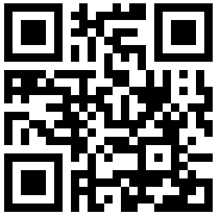
Join the conversation!
Scan the QR code to be added to the Webex space for Q&A and more

Slide 3
Agenda
01
Why APIs?
02
Coverage/Capabilities
03
Getting started
04
Use cases/Examples
05
Closing

Slide 4
Why APIs?
Notes:
11:02 Why APIs? (2 slides)

Slide 5


API, What, Where, and Why?
Definition: .. is a set of subroutine definitions, protocols, and tools for building application software. In general terms, it is a set of clearly defined methods of communication between various software components. .. Documentation for the API is usually provided to facilitate usage.”¹
APIs
Enabler for open systems integration
Universally available
Unleash developer innovation
¹Wikipedia

Slide 6
Webex Calling Provisioning Methods
Control Hub
CSV
API
Ease of Use
Speed
Customization

Slide 7
Coverage / Capabilities
Notes:
11:06 Coverage / Capabilities (3 slides)

Slide 8
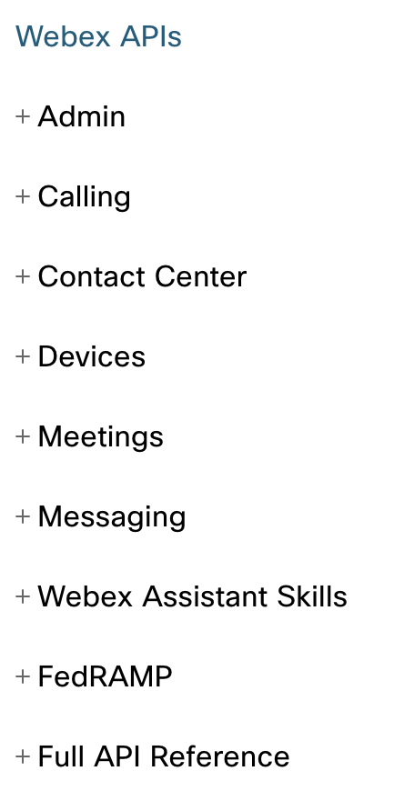
Webex APIs
Documentation: http://developer.webex.com
Various APIs available:
Admin (licenses, locations, memberships, people, ..)
Calling (call control, locations, people, org/location settings, …)
Devices (configuration, places, workspace locations, xAPI, …)
Meetings (invitees, participants, preferences, …)
…
Comprehensive coverage of Webex Calling
OAuth access token used for authorization

Slide 9
Webex Calling API Capabilities
Provisioning
Users (incl. calling entitlements), locations (r/o), call pickups, call queues, hunt groups, auto attendant, call parks, schedules, voice messaging settings, …
person settings: barge, call forwarding, call intercept, call recording, caller ID, voicemail settings, …
Coverage continuously growing*
Call Control
Dial, answer, reject, hangup, hold/resume, mute/unmute, divert, transfer, park/retrieve, start/stop/pause/resume recording, DTMF, push, pickup, barge
Webhook Notifications/Events
Voice messages
Call events
*Check https://help.webex.com/en-us/article/rdmb0/What's-new-in-Webex-Calling and https://developer.webex.com/docs/api/changelog for updates
References:
https://developer.webex.com/calling/docs/webex-calling-overview https://developer.webex.com/blog/calling-apis-overview
Notes:
[Hannes]
Overview of Webex API capabilities (what can be done generally, endpoints) – [5 mins]

Slide 10
Webex Calling Provisioning APIs
Locations, https://developer.webex.com/calling/docs/api/v1/locations
List locations
Get location details
Create/Update locations
Delete: not possible
People, https://developer.webex.com/admin/docs/api/v1/people*
List
CRUD
callingData parameter to access calling data (set, modify TN/extension)
*For user management use of the SCIMv2 user API is preferred: https://developer.webex.com/admin/docs/api/v1/scim-2-users Preferred endpoint for TN/extension assignment/updates: PATCH /licenses/users

Slide 11
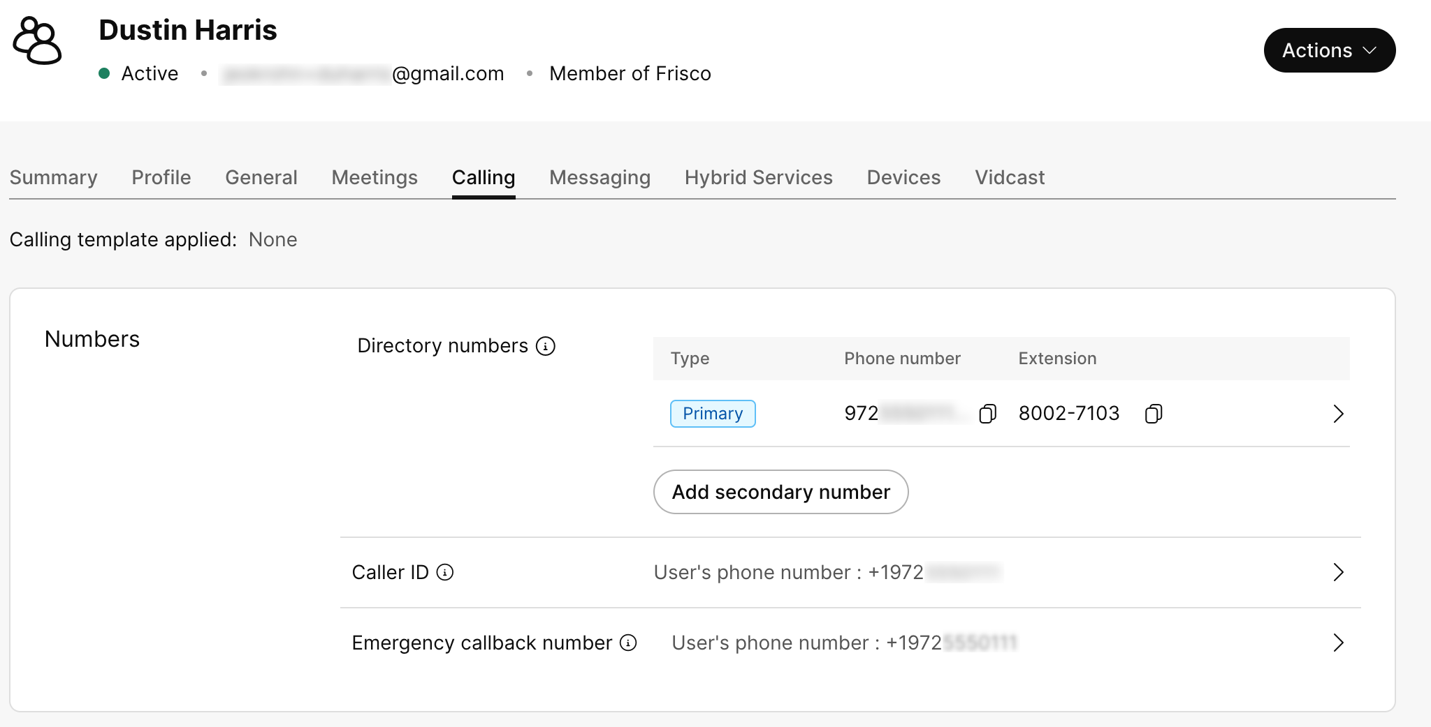
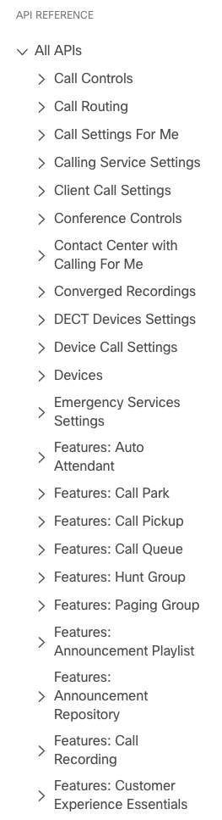
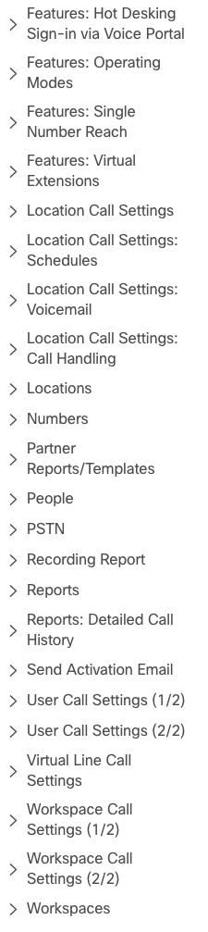
Webex Calling Provisioning APIs
Person Settings, https://developer.webex.com/calling/docs/api/v1/user-call-settings-1-2 https://developer.webex.com/calling/docs/api/v1/user-call-settings-2-2
Settings found in person’s Calling tab in Control Hub
Comprehensive coverage

Slide 12
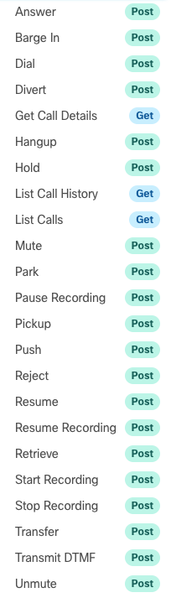
Webex Calling Call Controls
Actions
Dial, answer, reject, hangup, hold/resume, divert, transfer, park/retrieve, start/stop/pause/resume recording, DTMF, push, pickup, barge
Management
List, get details, call history
List/Details use common call object
Requires user access token
No org level (admin) operations

Slide 13
Webhook Notifications/Events
Webhook API to manage webhooks: https://developer.webex.com/meeting/docs/api/v1/webhooks
Resource: telephony_calls
Events: created, updated, deleted
https://developer.webex.com/docs/api/guides/webhooks

Slide 14
Telephony_call event example
Webhook ID
{
"id": "Y2lzY2…wMTc5",
"name": "d9c193c3-4787-4726-b9fa-6acff173e15a",
"targetUrl": "https://c780-149-249-133-109.ngrok.io/callevent/Y2lzY29...ZWIzZGE",
"resource": "telephony_calls",
"event": "created",
"orgId": "Y2lz…mUzZTc",
"createdBy": "Y2lz…ZGE",
"appId": "Y2lzY29zc…5NzZlZWQ0ODM1",
"ownedBy": "creator",
"status": "active",
"created": "2022-03-18T14:53:51.669Z",
"actorId": "Y2lzY2…2FjZWIzZGE",
"data": {
"eventType": "received",
"eventTimestamp": "2022-03-18T14:54:02.442Z",
"callId": "Y2lzY2…AxNDYxOTow",
"callSessionId": "Zjg1OWExYTYtNDI5NS00OTU0LWEwYzktMDY0MjFjOTY5Mzk3",
"personality": "terminator",
"state": "alerting",
"remoteParty": {
"name": "Henry Green",
"number": "7101",
"personId": "Y2lzY29z…zNTg",
"privacyEnabled": false,
"callType": "location"
},
"appearance": 1,
"created": "2022-03-18T14:54:02.440Z"
}
}
Webhook name
Target URL
Resource “telephony_calls” → call event
Created → new call
Id of app used to create the webhook
Information about the actual call

Slide 15
Webex Calling APIs Overview
PROVISIONING
CALL CONTROL
ANALYTICS & REPORTING
Customer Journey
Setup, Onboard, Manage
Call, Meet, Collaborate
Achieve Customer Success
Manage users, phone #s, locations, & services
Assign licenses
Create and manage location features
Place, answer, hang up calls
Stop / start / pause recording
Transmit DTMF digits
List active calls / get history
Detailed call records
Onboarding, usage, & quality reporting
Automated reporting setup
Representative Tasks
Installation, activation, & onboarding
Ongoing services management & care
Self-service via partner portal
Custom enterprise calling integrations
Cloud business platform integration
Custom app development
User training & adoption services
Business process design & optimization
Vertical solutions design & oversight
Sample Solutions

Slide 16
Getting Started
Notes:
11:12 Getting Started (3 slides)

Slide 17
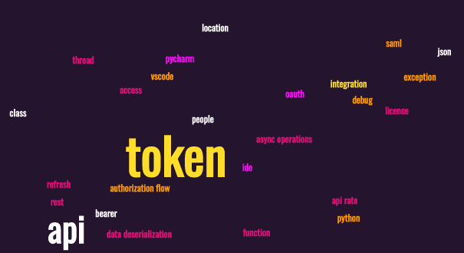
Using Webex APIs
Documentation at: https://developer.webex.com/
But: Steep learning curve
A lot of concepts to master
SDK helps to abstract from the “dirty details”

Slide 18
Developer Sandbox
Sandbox
playground to test API calls
Avoid impact on production org
Limited to 10 users
Allows to test capabilities not available w/ Webex free plans
No Cisco PSTN
Can add on-premises PSTN (Local Gateway) for PSTN access
https://developer.webex.com/admin/docs/developer-sandbox-guide

Slide 19
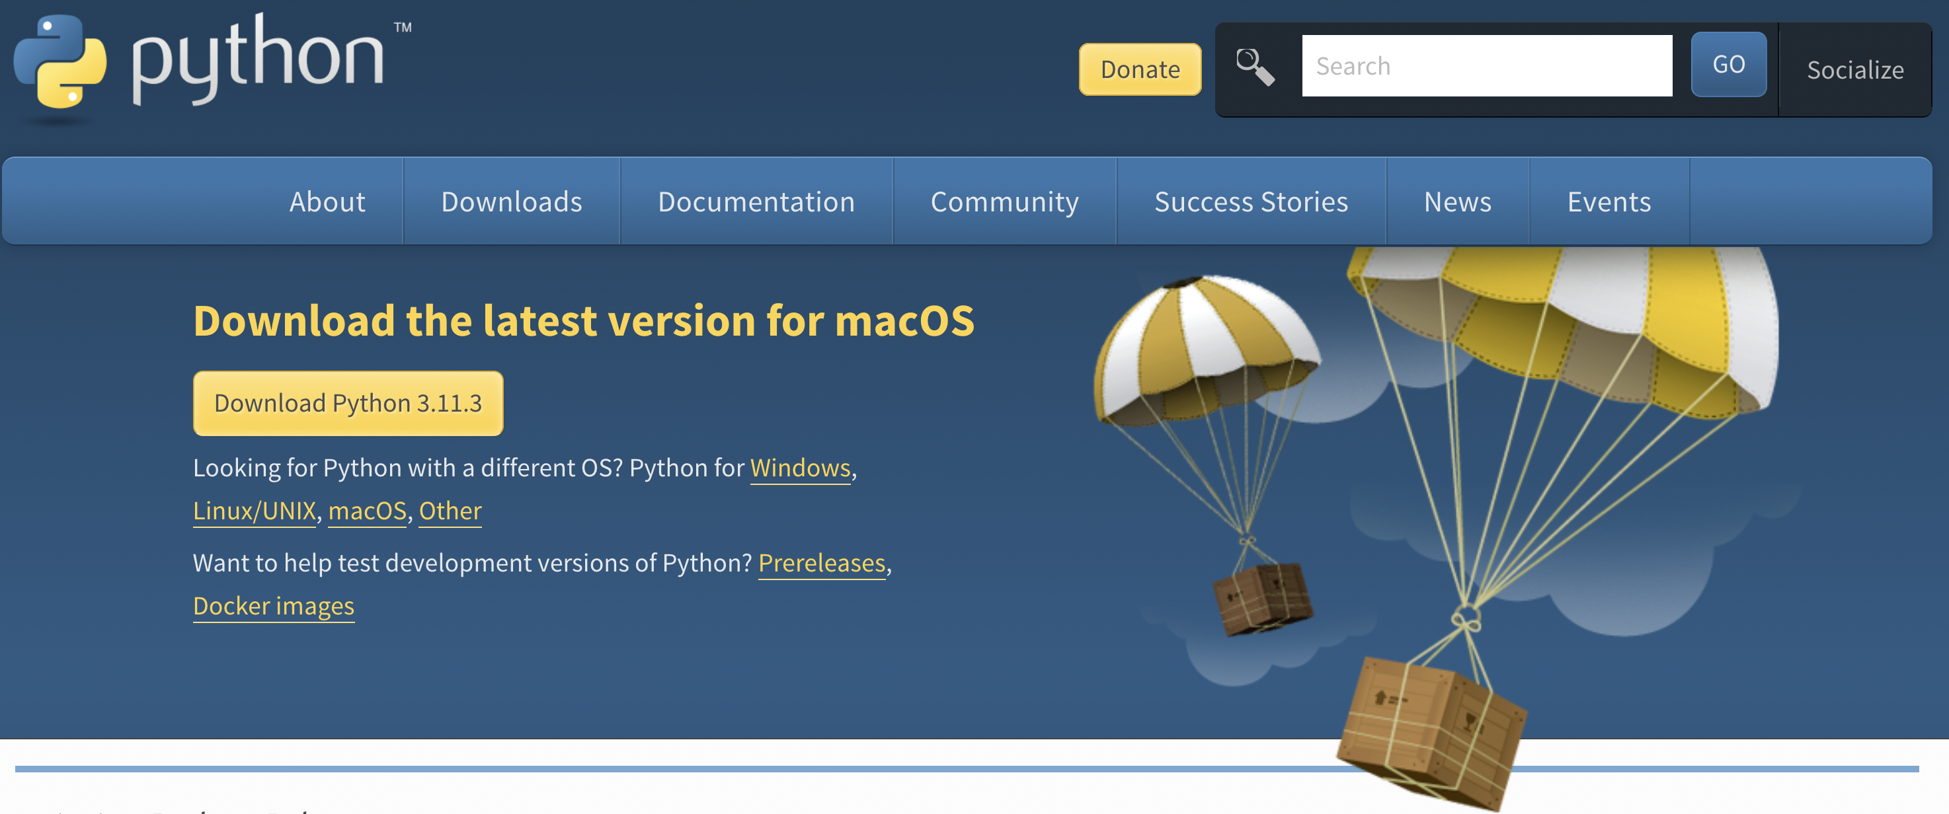

Installing Python
Installers are are available at https://www.python.org/downloads/
Mac tip: install Python via Homebrew: https://docs.python-guide.org/starting/install3/osx/
Avoids issues with GNU readline (for example when using https://pypi.org/project/cmd2/)

Slide 20
Tools
Notes:
11:18 Tools (4 slides)

Slide 21
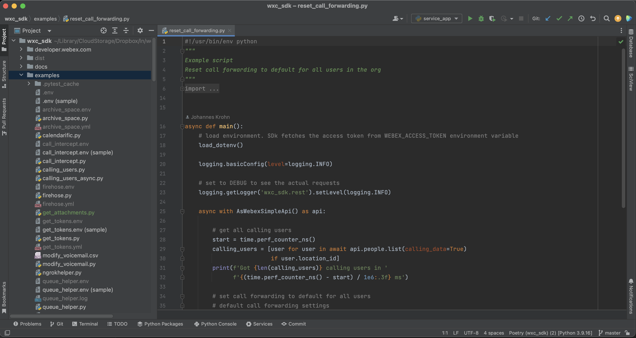
IDE – Integrated Development Environment
Helps to develop and test your application
Features
GUI
Editor
Build automation
Syntax highlighting
Debugger
Integration w/ revision control system (e.g. Git)
…

Slide 22
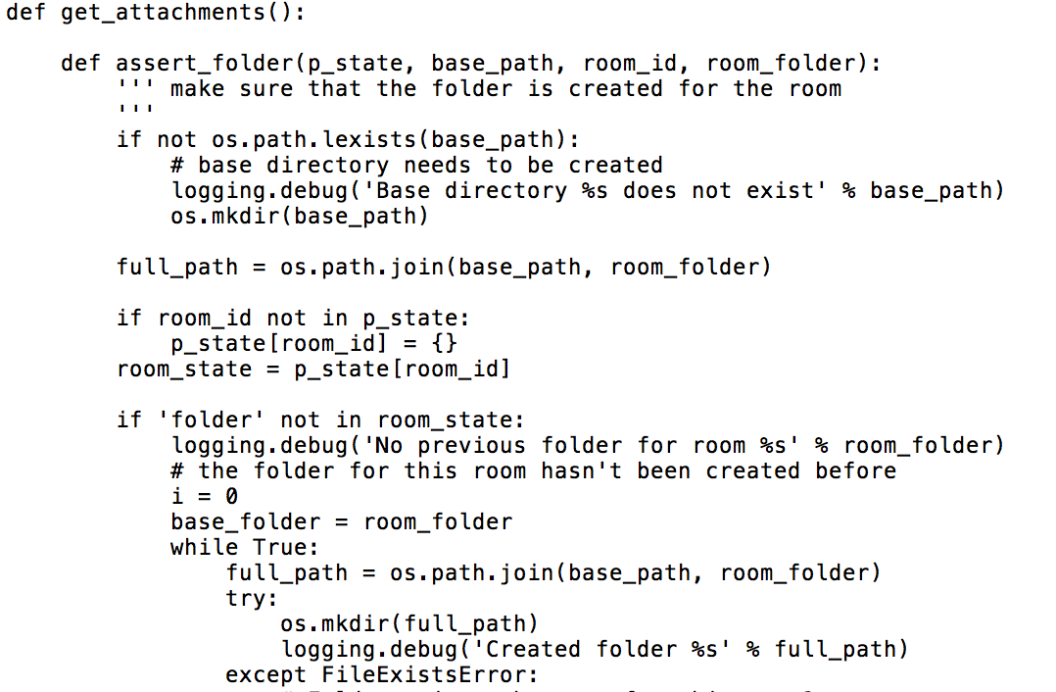
Syntax Highlighting
What Do you prefer?
This?

Slide 23
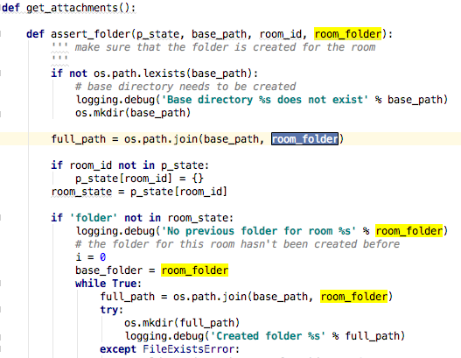
Syntax Highlighting
What Do you prefer?
Or this?

Slide 24
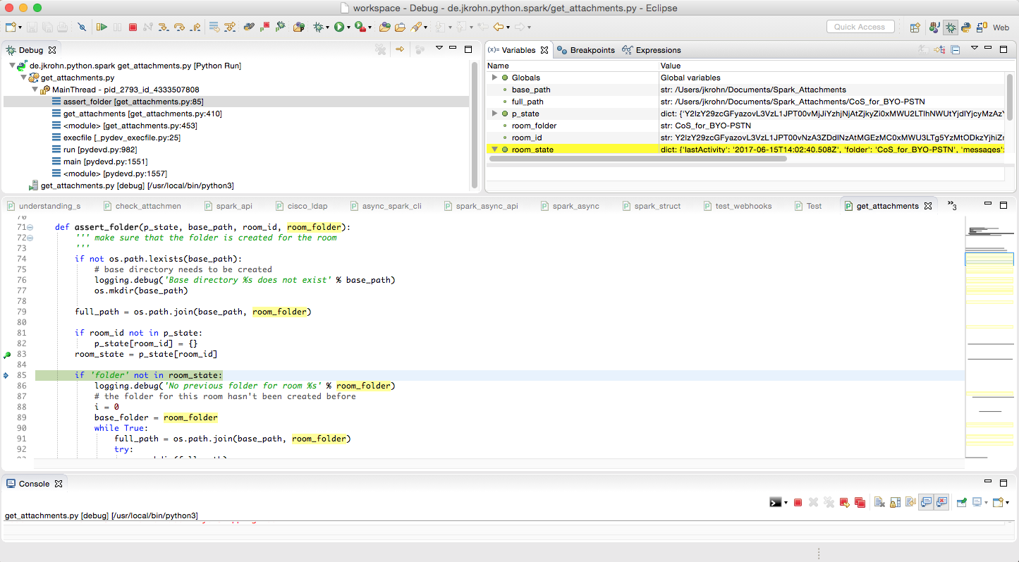
Live Debugger
Live Debugger allows to
Set breakpoints
Check variables
Evaluate expressions
→ Essential for effective SW development

Slide 25


IDEs for Python
IDLE (Standard IDE)
PyCharm
VS Code
PythonAnywhere

Slide 26

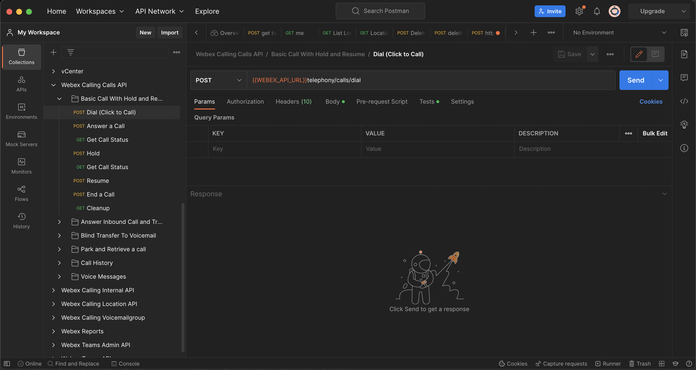
Postman: Test APIs
Share, test, document & monitor APIs
Easily test API calls
Generate code (Python, curl, ..)
Create collections
Available for Mac, Windows, Linux, and Chrome apps
https://www.getpostman.com/
Postman collection for Webex Messaging and Admin APIs: https://github.com/CiscoDevNet/postman-webex
Notes:
List rooms
Create webhook
Environments
Header presets
Code creation -> Python

Slide 27
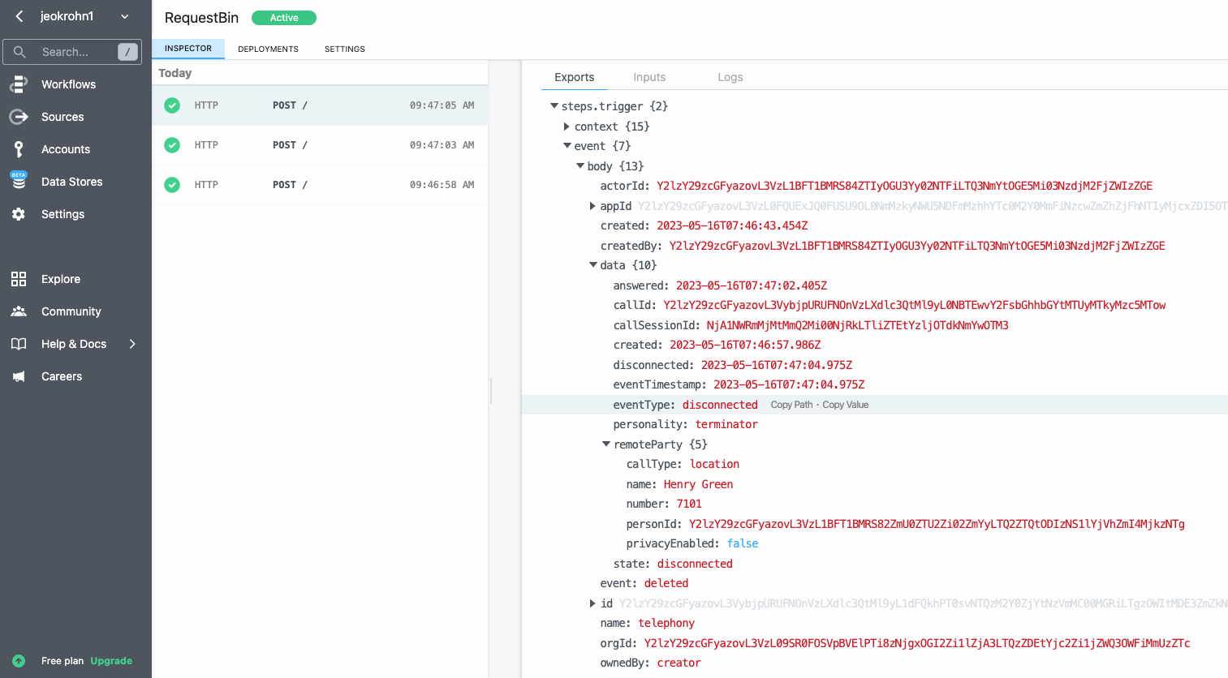
RequestBin: See Webhooks in Action
Free service: https://pipedream.com/requestbin
Creates unique URL
Use case: Webex webhook pointing to Requestbin to test webhook operation
Provides real-time view on requests hitting the URL

Slide 28

GitHub
Git repository hosting service
Offers
Revision control
Source code management
THE place to share your code

Slide 29
Consuming APIs
Notes:
11:26 Consuming APIs (8 slides)

Slide 30


REST – Representational State Transfer
Not really a standard – more an architecture
Uses existing standards: for example HTTP(S) for transport
All about client-server
Conceptually similar to web browser accessing web server
Resources
Every resource can be addressed by a URI
Methods: GET, PUT, POST, DELETE, HEAD
Uniform representation: typically JSON
Protocol
Stateless
Client-server

Slide 31
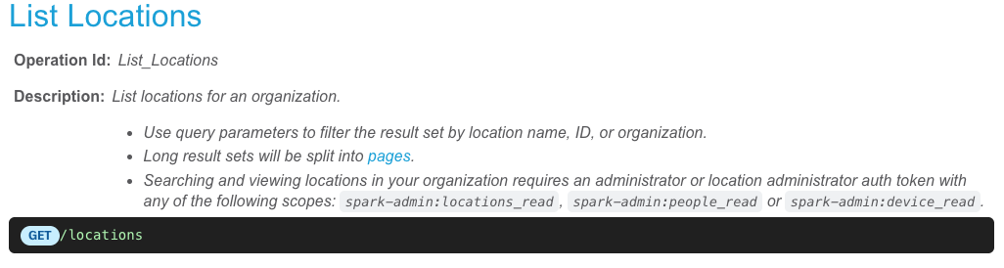
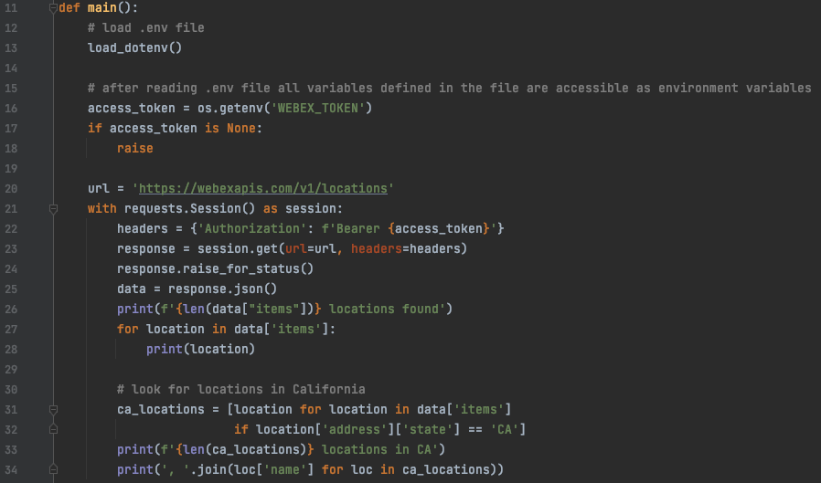
Calling a Webex API Endpoint Listing Webex Calling Locations
https://developer.webex.com/calling/docs/api/v1/locations/list-locations
URL of the endpoint
Session() from requests module is used
Fabricate the Authorization header
Call the endpoint
Check for errors
Parse the JSON response into a dict
Accessing the response values as dict keys
https://github.com/jeokrohn/BRKCOL-3015/blob/main/list_locations_direct.py

Slide 32
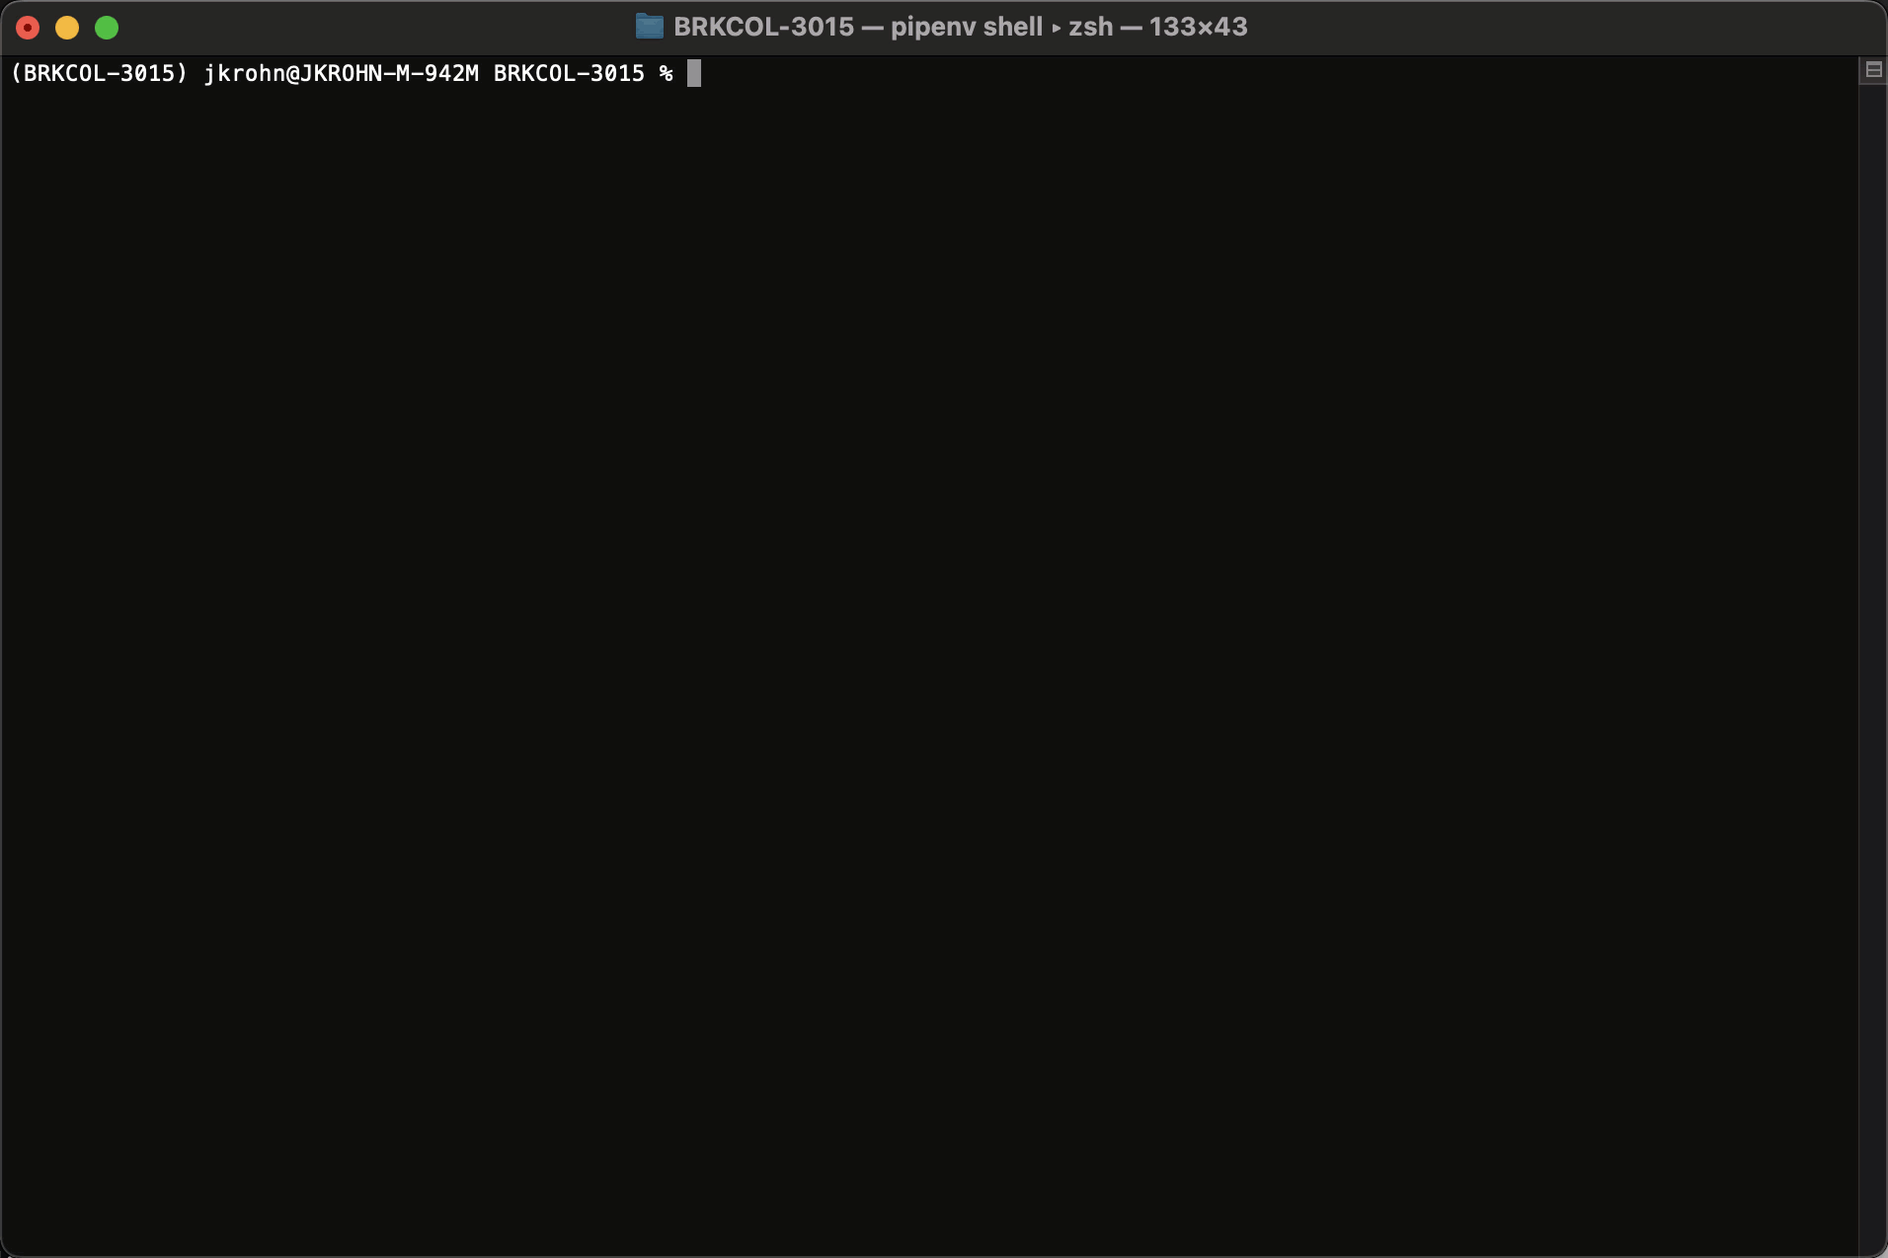
Calling a Webex API Endpoint Listing Webex Calling Locations

Slide 33
Calling a Webex API Endpoint Listing Webex Calling Locations
https://developer.webex.com/calling/docs/api/v1/locations/list-locations
URL of the endpoint
That was easy, but..
Accessing dictionary values by key is hard and error prone
Missing handling of 429 responses (throttling)
Missing pagination handling
Handling of additional parameters (name, id)
There has to be a better way?!
Session() from requests module is used
Fabricate the Authorization header
Call the endpoint
Check for errors
Parse the JSON response into a dict
Accessing the response values as dict keys

Slide 34
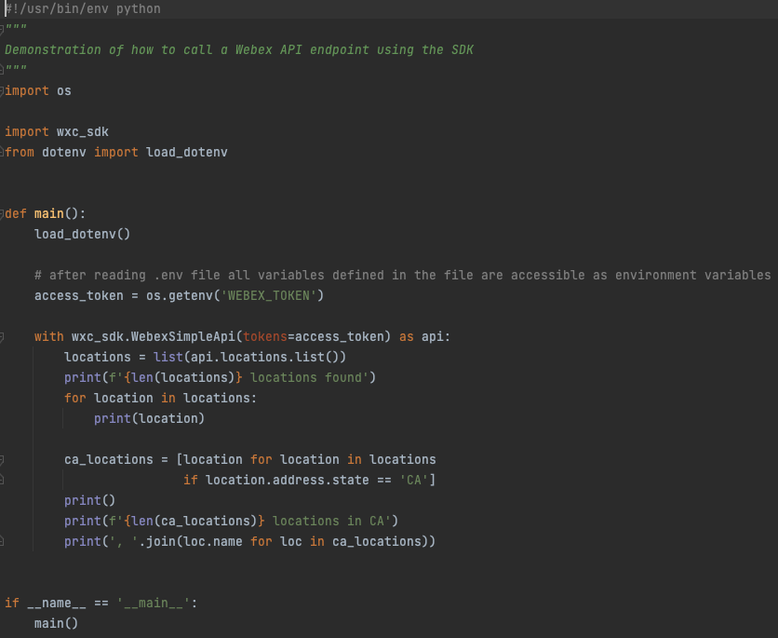
wxc_sdk: SDK for Webex Calling APIs
PyPi: https://pypi.org/project/wxc-sdk/
Homepage: https://github.com/jeokrohn/wxc_sdk
Documentation: https://wxc-sdk.readthedocs.io/en
Simple SDK to work with Webex APIs
Focus on Webex Calling specific endpoints ... and more
Takes care of all the “ugly” stuff
JSON (de-)serialization, authentication, 429 retries,
Pagination, …
Logging
Python objects for all API objects
Tab completion → efficient coding
Actively maintained
New API endpoints will be added continuously
Foundation for your provisioning automation and other projects around Webex Calling

Slide 35
Calling a Webex API Endpoint Listing Webex Calling Locations using the SDK
The API object
Get list of locations
Access data using attributes of Python classes
https://github.com/jeokrohn/BRKCOL-3015/blob/main/list_locations_sdk.py

Slide 36
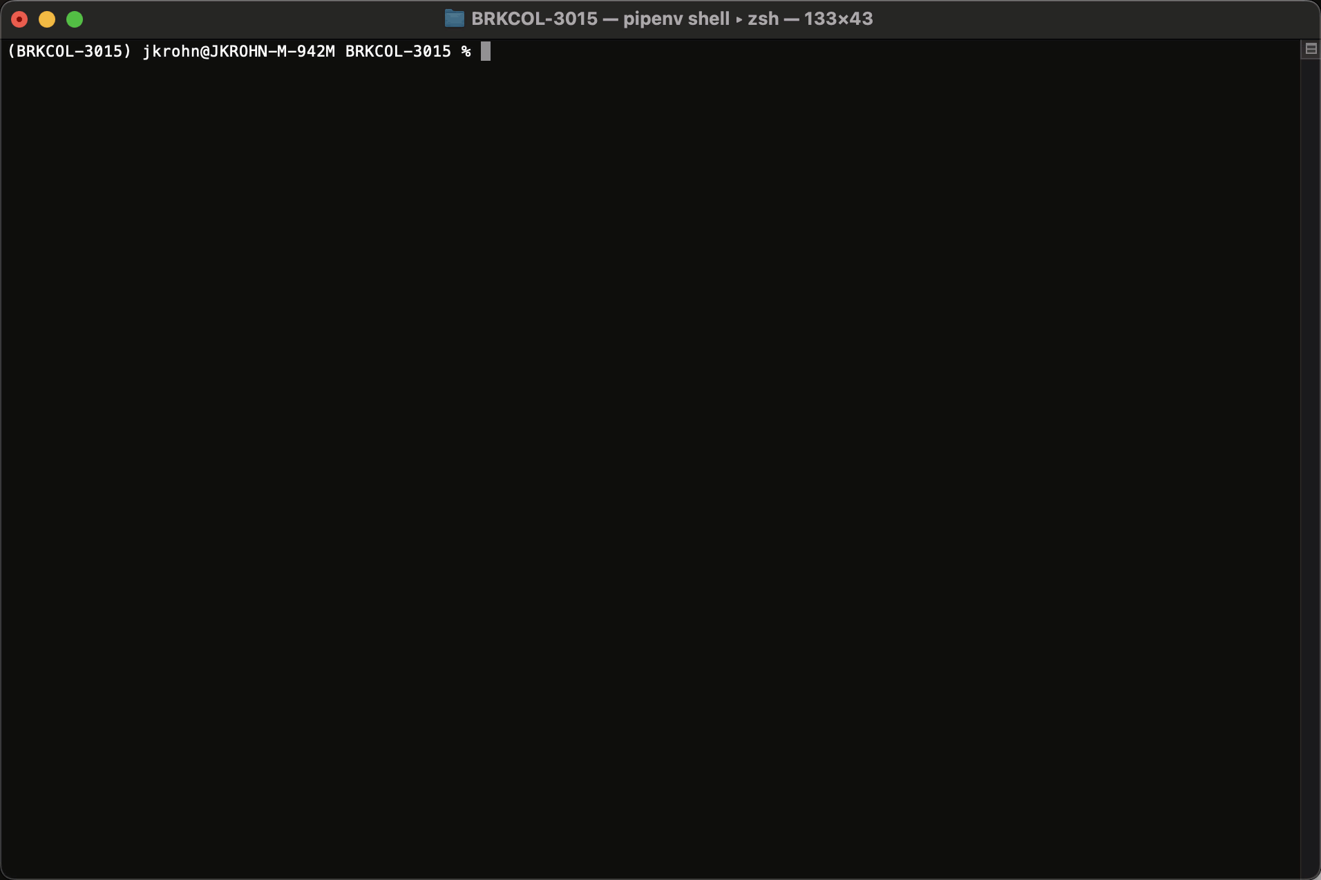
Calling a Webex API Endpoint Listing Webex Calling Locations using the SDK

Slide 37
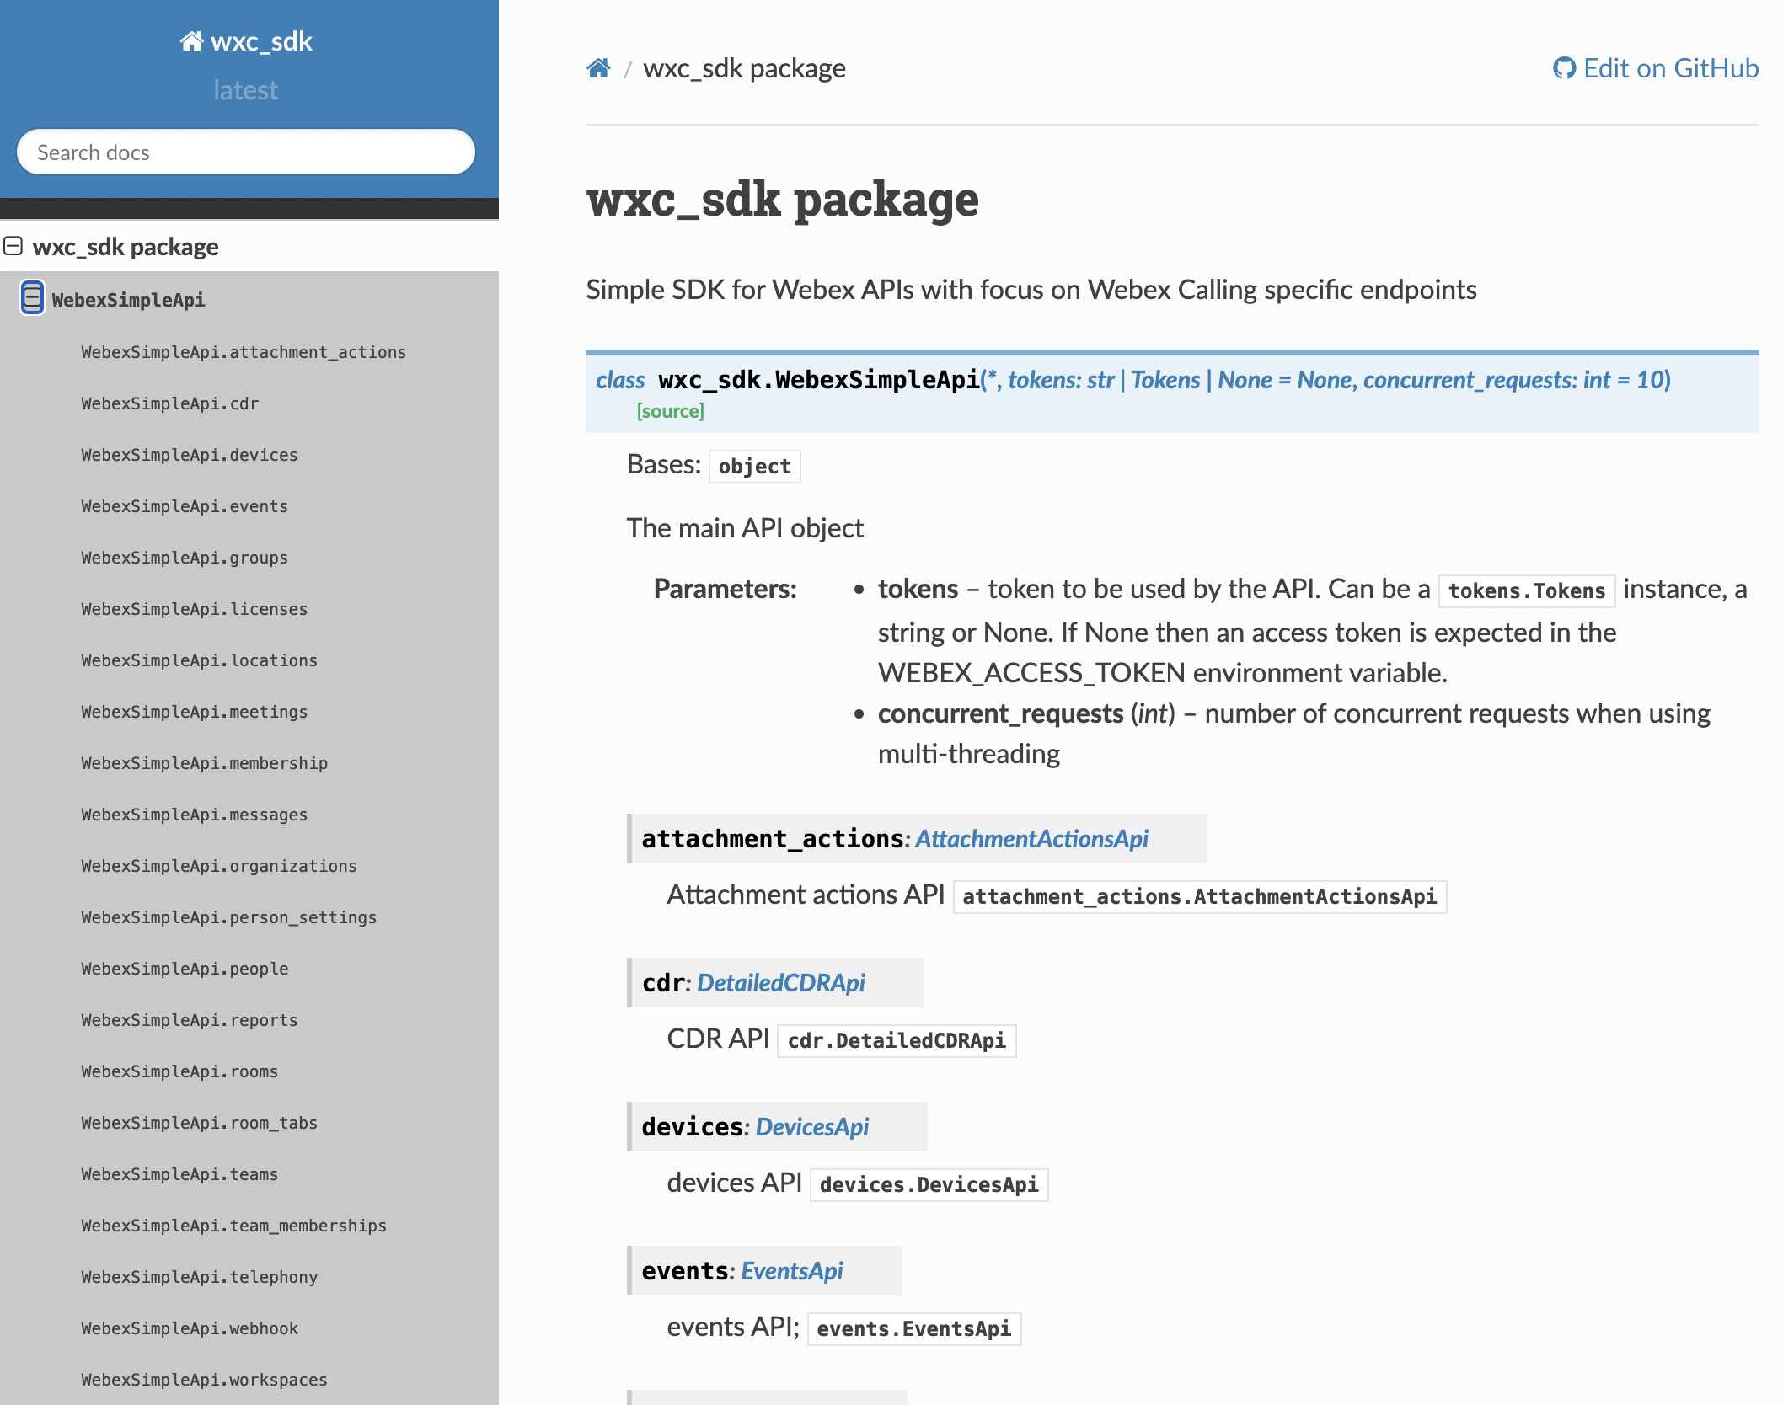
wxc_sdk: Comprehensive Coverage
SDK covers all Webex Calling specific API endpoints
Additionally:
Licenses, memberships, messages, people, teams, team memberships, webhooks, …
Available methods:
https://wxc-sdk.readthedocs.io/en/1.26.0/user/method_ref.html
Easy token management
https://wxc-sdk.readthedocs.io/en

Slide 38
Tokens
Notes:
11:43 Tokens (17 slides)

Slide 39
Tokens Why and How?
Access tokens are required to authorize API accces
.. Can be obtained in different ways:
Personal access token (developer token)
Integration (OAuth2 authorization flow)
Service App
NEVER(!!!) store tokens in your source files
NEVER(!!!) push tokens to GitHub repositories
NEVER(!!!) share tokens in any shape or form
Best practice:
In your code read access token from environment variable
Use dotenv.loadenv() to load .env file with environment variables
Exclude .env from version control (Git) by adding exclusion in .gitignore
Integration tokens can be cached in local files .. but make sure to restrict access and not push to GitHub
GET https://webexapis.com/v1/people
User-Agent: python-requests/2.30.0
Accept-Encoding: gzip, deflate
Accept: */*
Connection: keep-alive
Authorization: Bearer MGY4MzNjNzgt***
content-type: application/json;charset=utf-8
https://developer.webex.com/calling/docs/getting-started

Slide 40
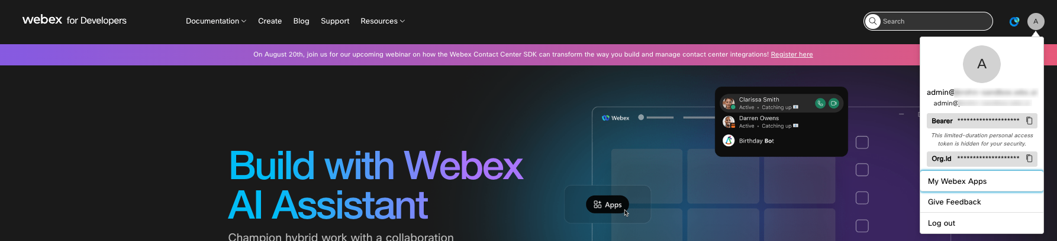
Personal Access Token
From developer.webex.com
Limited lifetime (12 h)
Should NEVER be used in production
Testing only

Slide 41
Integration – The Better Way to Obtain Tokens
Act on behalf of a Webex user
Access equivalent to a real Webex user (limited by authorized scopes)
Invoke Webex APIs on behalf of user
Requires authorization of integration by user
OAuth Grant Flow to authenticate user and ask for authorization
User approves authorization levels (scopes) requested by the integration
Each Integration has a client ID, client secret and redirect URI
Documentation: https://developer.webex.com/docs/integrations

Slide 42
OAuth Authorization Code Flow
1. Application Requests auth code Browser redirect to Webex Authentication
2. Webex returns the auth code to application Browser redirect to Application
3. Request an access token HTTP GET request to Webex API
4. Application gets access token and refresh token HTTP GET response from Webex API
Notes:
Good & detailed explanation of oAuth: https://stormpath.com/blog/what-the-heck-is-oauth
Your Spark password is NOT stored on the 3rd party service, instead you create an agreement for the 3rd party service to do xyz on your behalf.
duittenb@cisco.com
duittenb@cisco.com

Slide 43
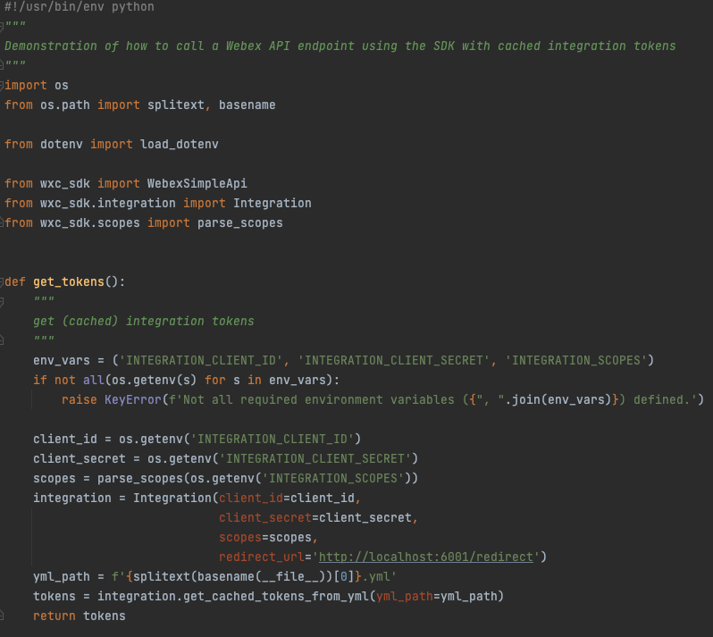
Integration Tokens in Scripts Using wxc_sdk
wxc_sdk offers an easy way to work with cached tokens in scripts
Cache tokens in YML file
Get tokens from OAuth flow redirecting to http://localhost:6001/redirect
Spin up temporary (primitive) server to handle final step of OAuth flow
Prepare integration based on values read from environment
Read, create, refresh, cache tokens
access_token: ZGVlY2***
expires_at: '2023-05-30T14:35:37.246110+00:00'
refresh_token: NTlk***
refresh_token_expires_at: '2023-08-14T14:08:57.246110+00:00'
token_type: Bearer
https://github.com/jeokrohn/BRKCOL-3015/blob/main/list_locations_sdk_int_tokens.py

Slide 44
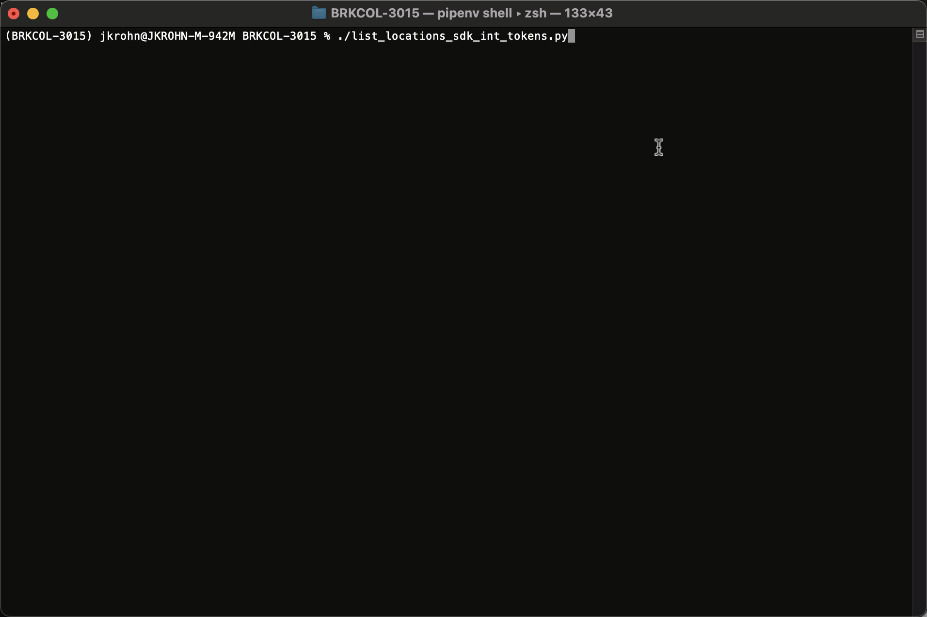
Integration Tokens in Scripts Using wxc_sdk
Without cached tokens OAuth flow gets initiated
Auth code exchanged for tokens
Tokens are cached
Next execution uses cached tokens
https://github.com/jeokrohn/BRKCOL-3015/blob/main/list_locations_sdk_int_tokens.py

Slide 45
Service Apps
Machine account
Request admin permission independent of user account
Use cases
Provisioning
Reporting
Scheduling systems
…
Similar to integrations .. but no user specific authorization flow
https://developer.webex.com/admin/docs/service-apps

Slide 46

Using Service App Tokens
Developer
Admin
Register service app
Request admin authorization
Admin authorizes app
Client id
Retrieve access and refresh token
Use access token to make API calls
Token lifetime expired
Refresh token
Get new access token
Client id and secret

Slide 47

Using Service App Tokens
Developer
Admin
Register service app
Request admin authorization
Admin authorizes app
Client id
Retrieve access and refresh token
Use access token to make API calls
Refresh token
Get new access token
Client id and secret

Slide 48
Using Service App Tokens
Developer
Admin
Register service app
Developer.cisco.com, “My Webex apps”
Define:
Name
Icon
Description
Contact email address
Scopes
Collect
Client id
Client secret
Request admin authorization
Admin authorizes app
Client id
Retrieve access and refresh token
Use access token to make API calls
Token lifetime expired
Refresh token
Get new access token
Client id and secret

Slide 49
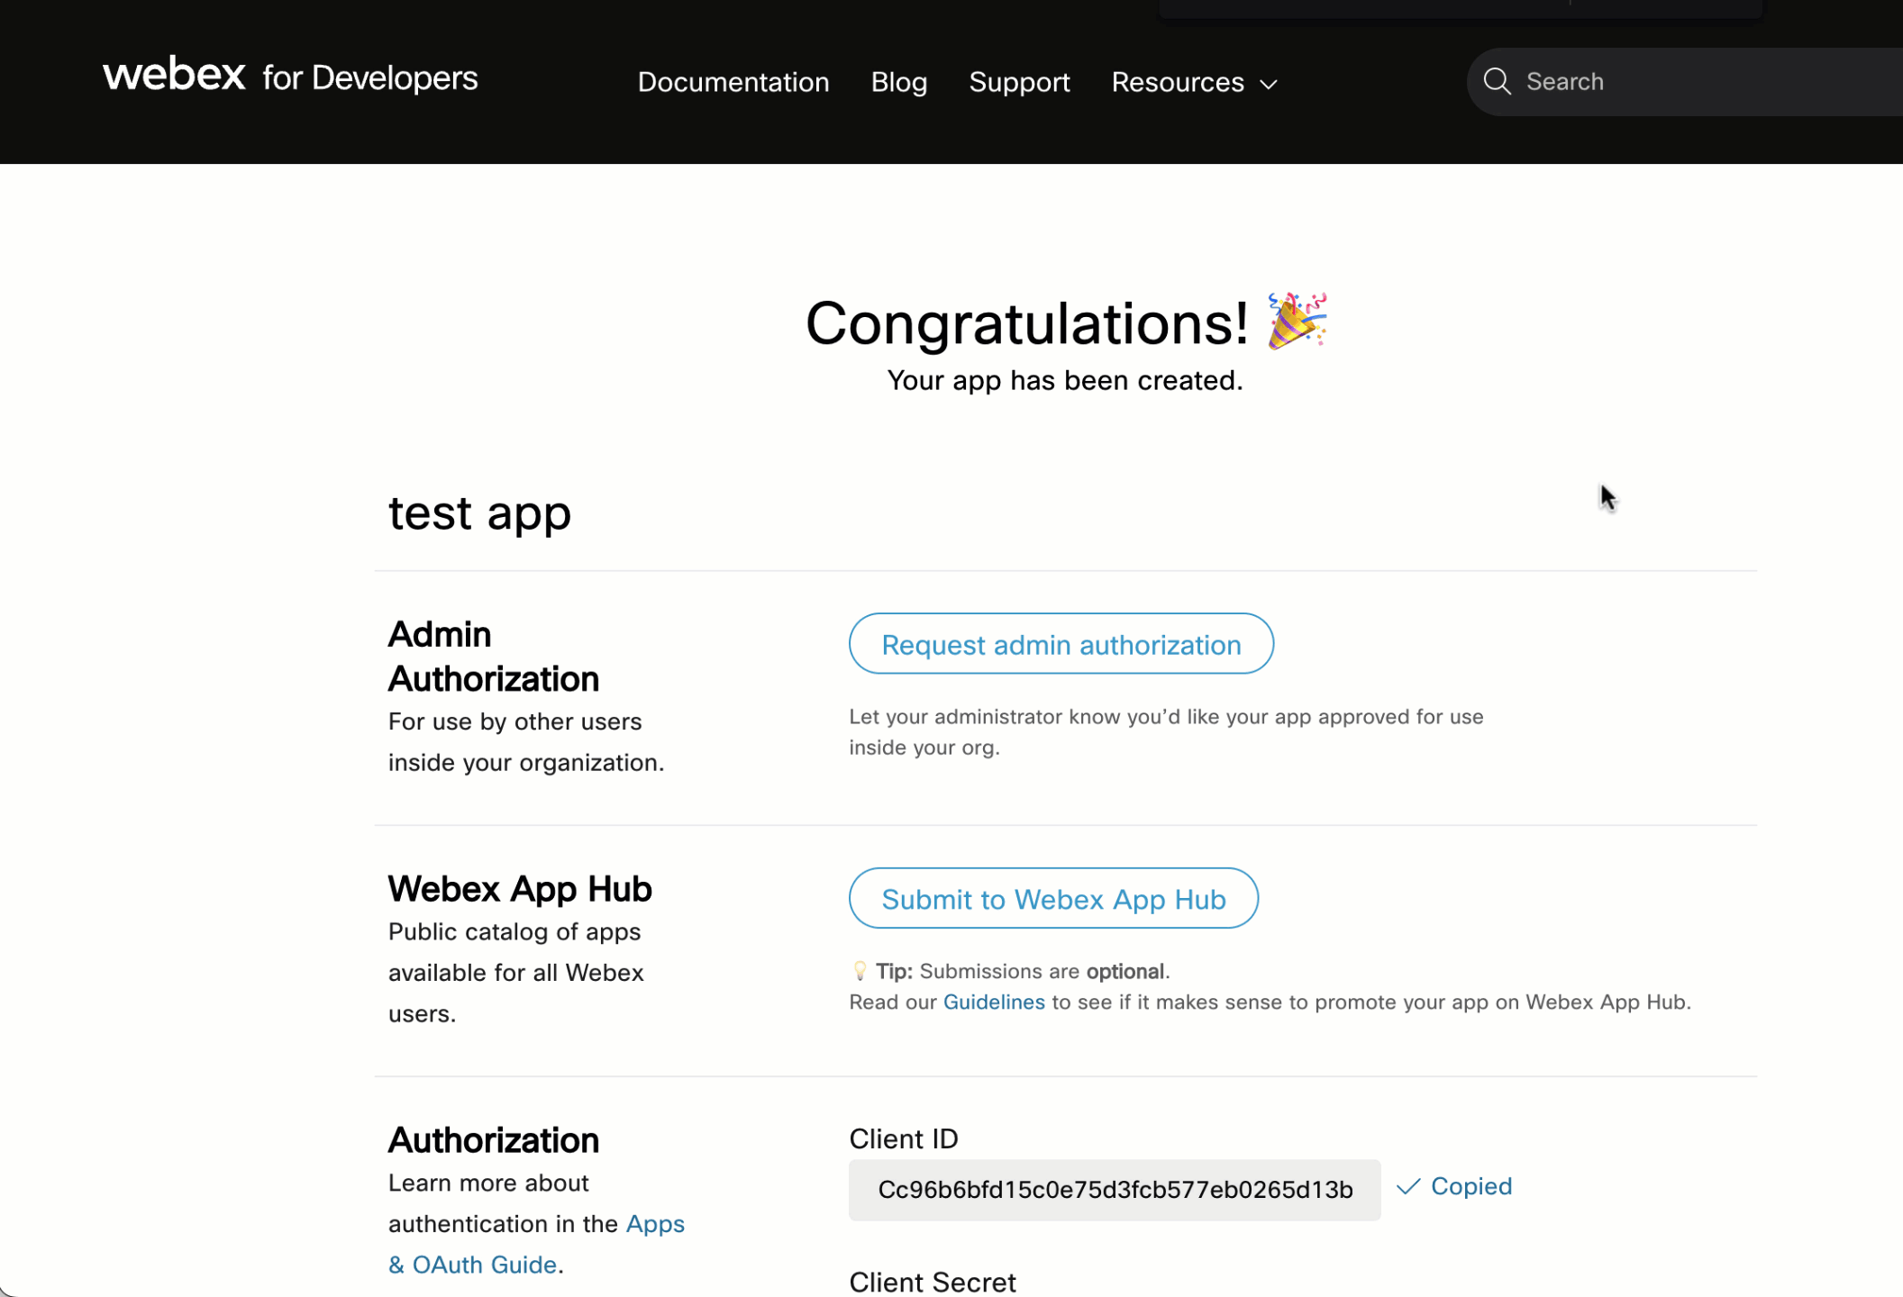
Using Service App Tokens
Developer
Admin
Register service app
Request admin authorization
Admin authorizes app
Client id
Retrieve access and refresh token
Use access token to make API calls
Token lifetime expired
Refresh token
Get new access token
Client id and secret

Slide 50
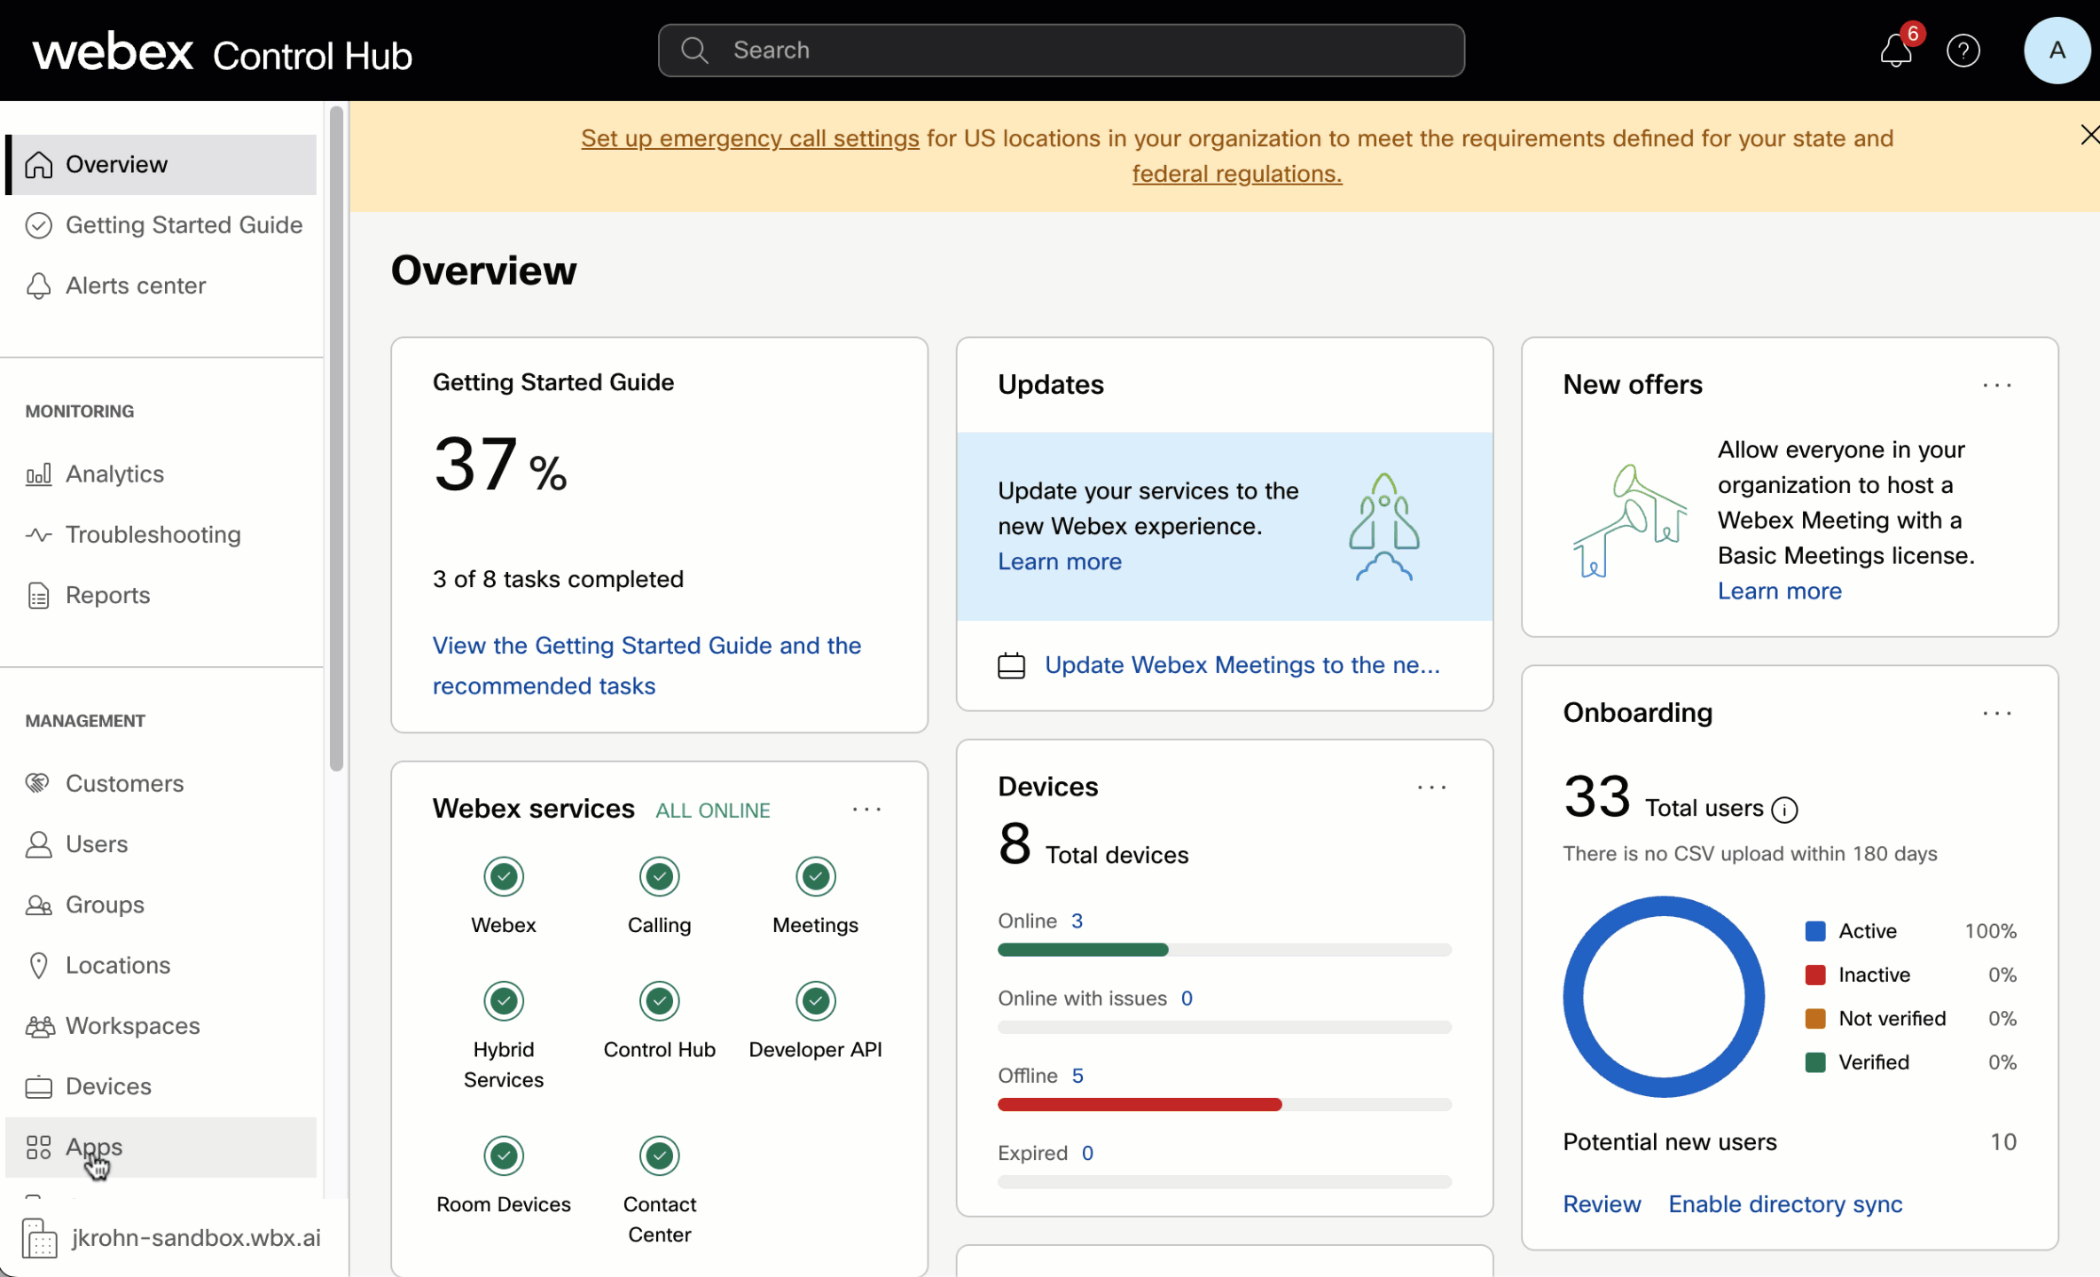
Using Service App Tokens
Developer
Admin
Register service app
Request admin authorization
Admin authorizes app
Retrieve access and refresh token
“Apps” section in Control Hub
Review scopes
Authorizing user is documented
Use access token to make API calls
Token lifetime expired
Refresh token
Get new access token
Client id and secret

Slide 51
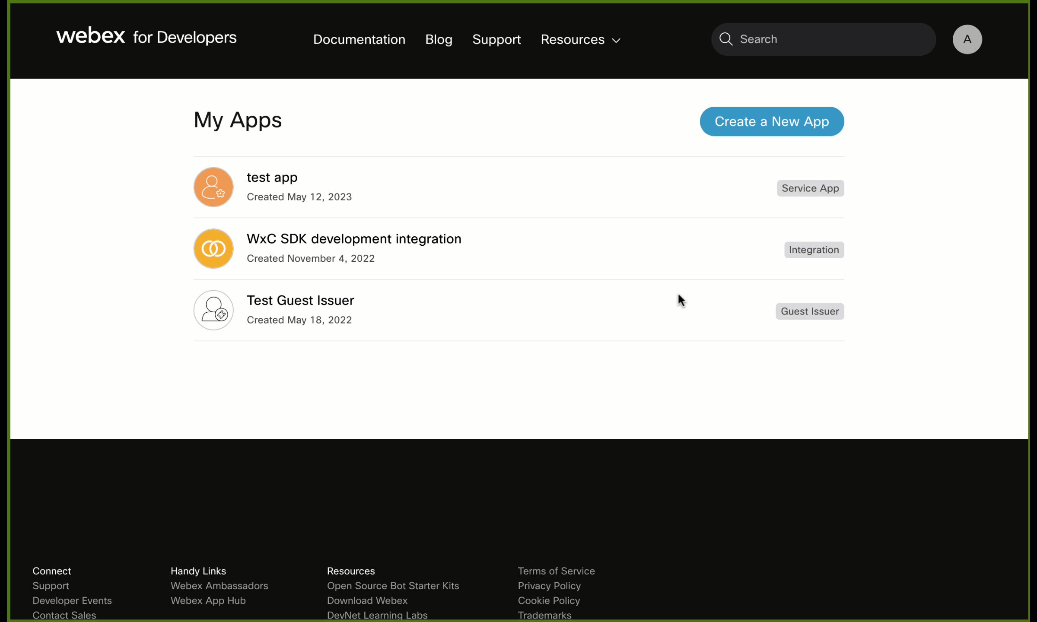
Using Service App Tokens
Developer
Admin
Register service app
Request admin authorization
Admin authorizes app
Client id
Retrieve access and refresh token
Use access token to make API calls
Token lifetime expired
Developer requests tokens for authorized org
Client secret needed to authorize the request
Refresh token
Get new access token
Client id and secret

Slide 52
Using Service App Tokens
Developer
Admin
Register service app
When getting close to token lifetime
New access token can be obtained using the refresh token
POST https://webexapis.com/v1/access_token
Content-Type: application/x-www-form-urlencoded
--- body ---
grant_type: refresh_token
client_id: ***
client_secret: ***
refresh_token: ***
Response
Content-Type: application/json
--- response body ---
{
"access_token": "***",
"expires_in": 1209599,
"refresh_token": ”***",
"refresh_token_expires_in": 7775954,
"token_type": "Bearer",
"scope": "spark:kms …"
}
Request admin authorization
Admin authorizes app
Client id
Retrieve access and refresh token
Use access token to make API calls
Token lifetime expired
Refresh token
Get new access token
Client id and secret

Slide 53
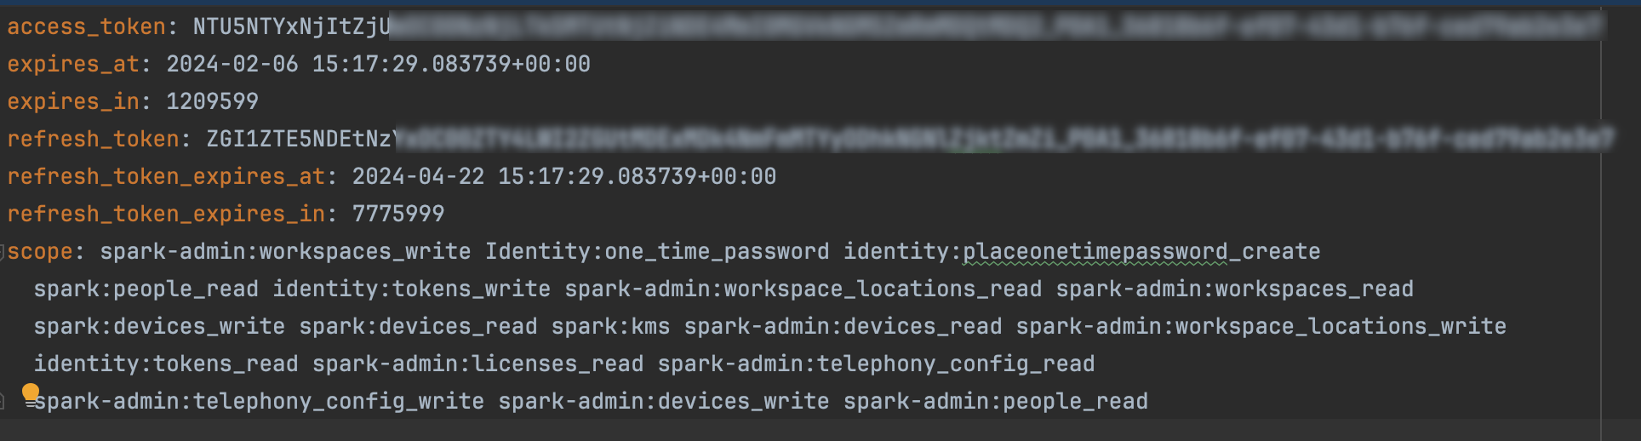
Using Service App with wxc_sdk
Read secrets from environment
Create access token and persist tokens in YML file
Use tokens to call endpoints
https://github.com/jeokrohn/wxc_sdk/blob/master/examples/service_app.py

Slide 54
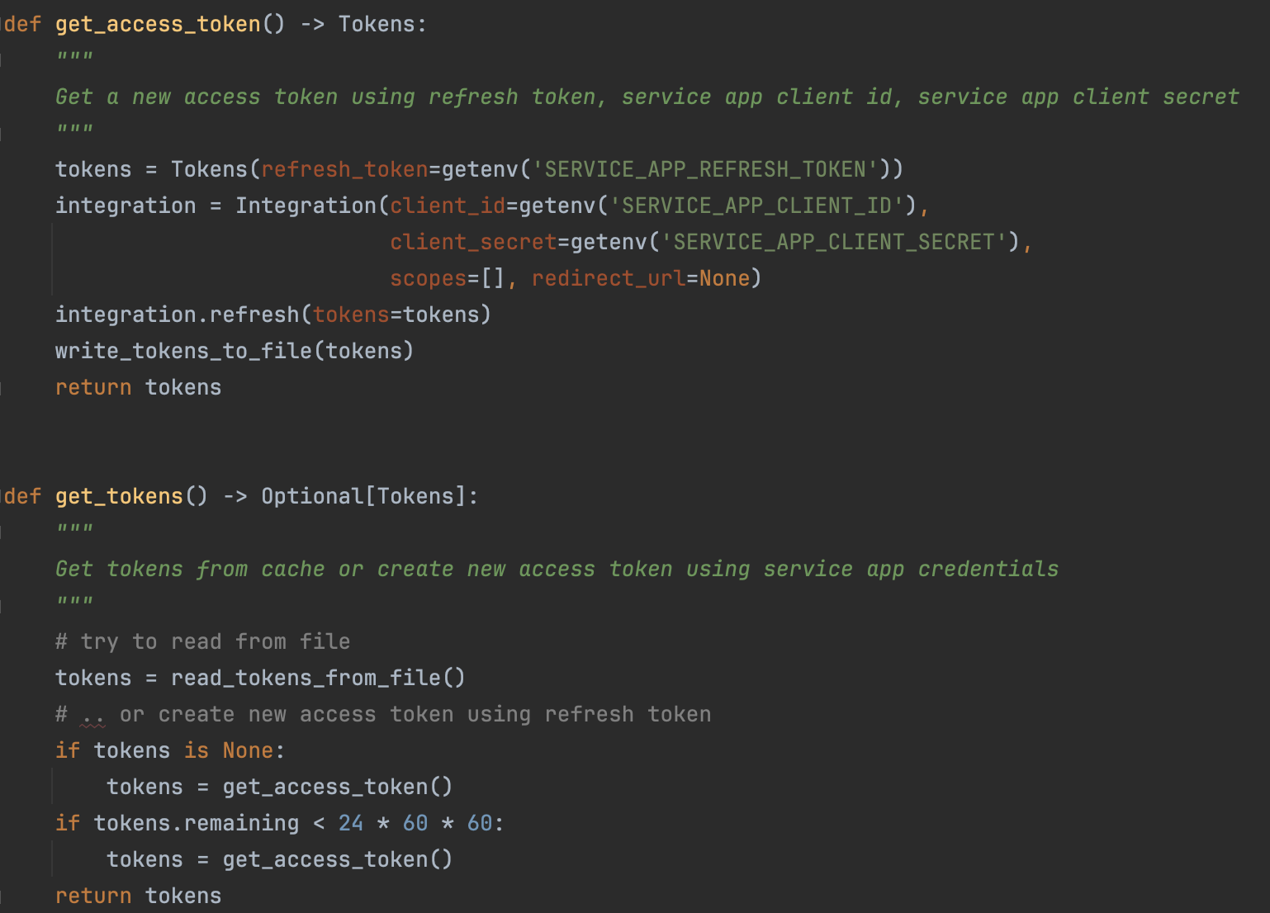
Using Service App with wxc_sdk
Read secrets from environment
Create access token and persist tokens in YML file
Use tokens to call endpoints
https://github.com/jeokrohn/wxc_sdk/blob/master/examples/service_app.py

Slide 55
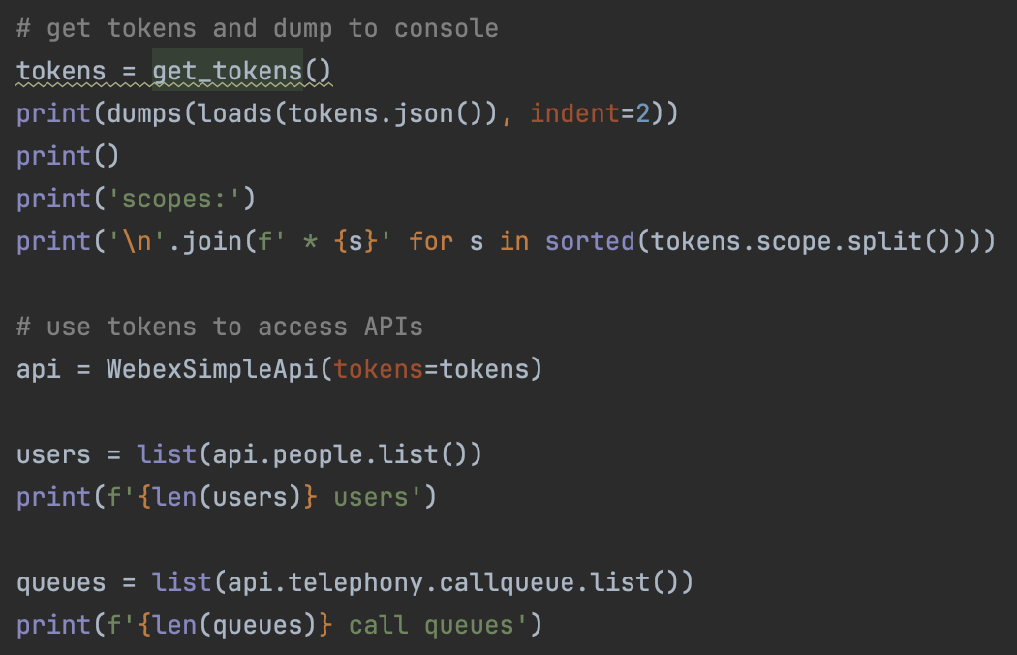
Using Service App with wxc_sdk
Read secrets from environment
Create access token and persist tokens in YML file
Use tokens to call endpoints
https://github.com/jeokrohn/wxc_sdk/blob/master/examples/service_app.py

Slide 56
Token Overview
 | Developer Token | Integration Token | Service App Token
How to get | From developer.webex.com | Requires OAuth auth code authorization flow, web server required | Service app access to org granted by org admin. Service app owner creates token on developer.webex.com
Granular Access Control | No, always has all scopes | Set of scopes assigned to integration | Set of scopes assigned to service app
Actor | Owner of developer token | User granting authorization | Service app
Lifetime | 12 hrs | Access token: 14 d Refresh token: 90 d (extended when getting new access token) | Access token: 14 d Refresh token: 90 d
Use cases | Development, Tests | (Web) applications acting on behalf of user | (Web) services explicitly authorized by org admin

Slide 57
Use Cases / Examples
Notes:
12:17 Use Cases / Examples (12 slides)

Slide 58
Use Cases
Scripts
Bulk Provisioning: user, calling features, …
Validation: check/verify settings; scripting saves you from navigating through individual menus in ControlHub
Automation reduces the risk of errors in repetitive tasks
CLI tools
Integration with existing enterprise mangement systems/tools
Backend for web services (portal applications)

Slide 59
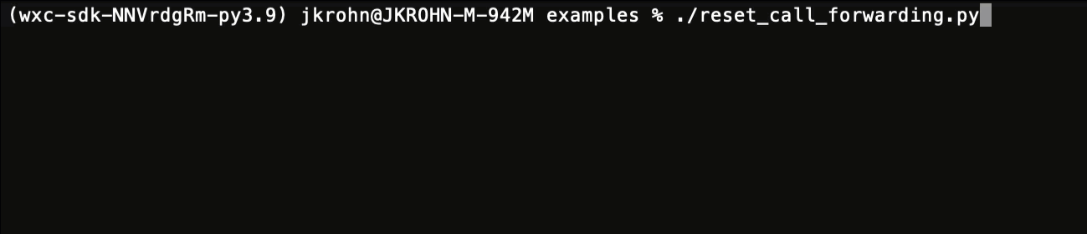
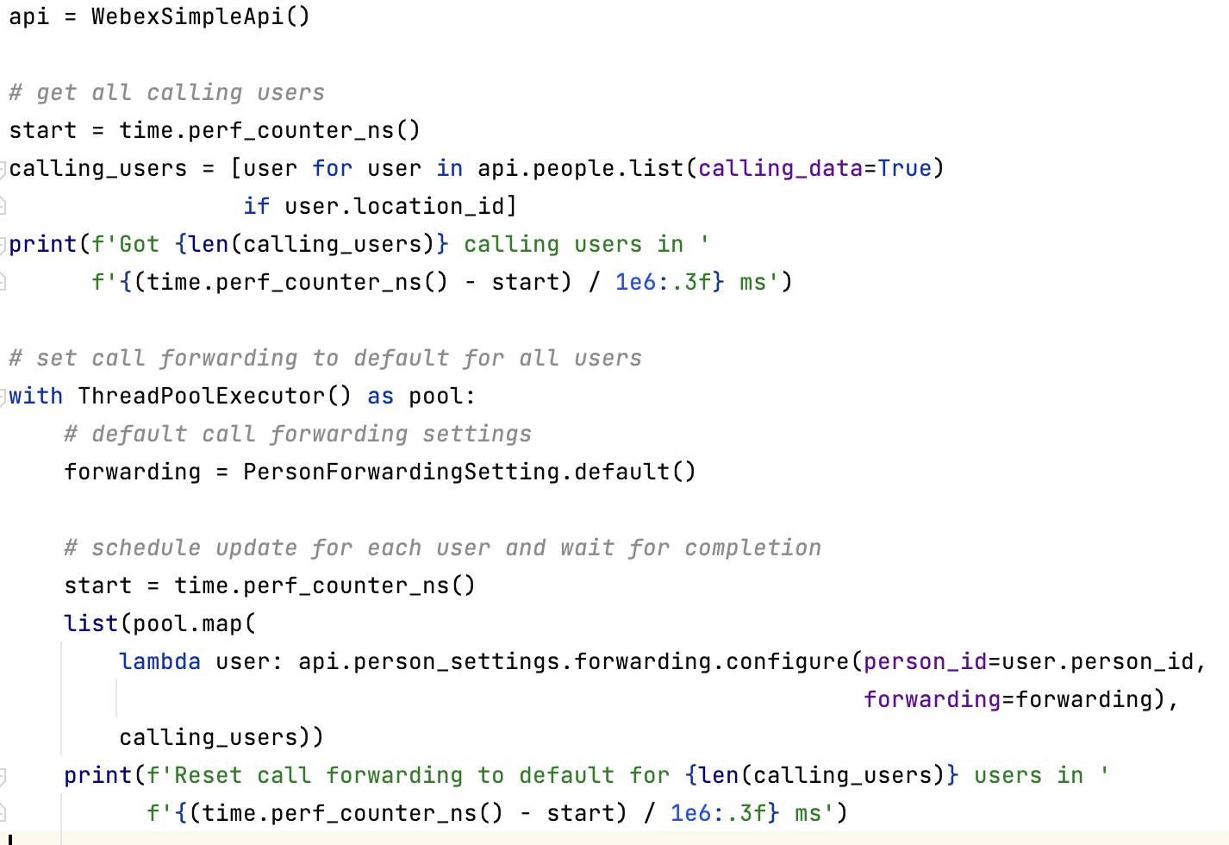
SDK Examples
Examples available at: https://wxc-sdk.readthedocs.io/en/latest/examples.html https://github.com/jeokrohn/wxc_sdk/tree/master/examples

Slide 60
Examples
queue_helper.py: read/update call queue join state of users
call_intercept.py: read/update call intercept settings of a user
us_holidays_async.py: create schedule with US holidays for all US location
reset_call_forwarding.py: reset call forwarding settings for all users
users_wo_devices.py: identify users without devices
catch_tns.py: pool unassigned TNs on hunt groups to catch calls to unassigned TNs
room_devices.py: remove calling entitlements from selected Workspaces
…

Slide 61
Example: User Web Portal

Slide 62
User Web Portal
Only a limited set of configuration options is available for users on settings.webex.com
User portal can expose additional options (which usually require admin privileges)
Perfect example for using service app tokens
User does not have the required privileges → integration token granted by user not sufficient

Slide 63
Concepts
Web based portal
Authenticate users using “Login with Webex”
For provisioning operations portal uses service app tokens
No tokens exposed in browser
Browser only interacts with portal endpoints
Includes Javascript Ajax access
Portal acts as proxy between browser and Webex APIs
APIs implemented using flask-restx → Swagger UI for free
https://developer.webex.com/create/docs/login-with-webex https://github.com/jeokrohn/BRKCOL-3015

Slide 64
Login with Webex
Portal (Web server)
User
Browser
Webex
Initiates login
Access authentication URL
/authenticate
Redirect to URL to start auth flow
Access URL to start auth flow
User authenticates
Redirect to redirect URL (portal) w/auth code
Access redirect URL w/ auth code
/authorize
Request ID token, use ID token to get info about authenticated user, set session context

Slide 65
Login with Webex
Portal (Web server)
User
Browser
Webex
Initiates login
Access authentication URL
/authenticate
Redirect to URL to start auth flow
Access URL to start auth flow
User authenticates
Web server not involved
Redirect to redirect URL (portal) w/auth code
Access redirect URL w/ auth code
/authorize
Request ID token, use ID token to get info about authenticated user, set session context

Slide 66
Portal Transactions
User
Browser
Portal
Webex
Opens dashboard page
Access portal
Interact with APIs
Render page
Javascript AJAX access
Interact with APIs
AJAX response
Changes settings
Javascript AJAX access
Interact with APIs
AJAX response

Slide 67
Rendering Data
index.html
{% block scripts %} <script type="text/javascript"> $(document).ready(function () { … // set up DataTable for phones $('#userPhones').DataTable({ searching: false, data: [], columns: [ {title: "Model", data: "model"}, {title: "Mac", data: "mac"}, {title: "Status", data: "status"}, ] }); update_user_phones()
index.html
<!-- phones --> <div class="row"> <div class="col-xl-8 col-lg-7 mb-4" id="phoneCard"> <div class="card shadow mb-4 h-100"> <div class="card-header py-3">Phones</div> <div class="card-body"> <div class="table-responsive"> <table class="table table-striped table-bordered dt-responsive nowrap" id="userPhones"> <!-- the table is empty and will be set in $(document).ready --> </table> </div> <div class="row"> <div class="text-xs" id="status"> </div> </div> </div> </div> </div> </div>

Slide 68
Rendering Data
index.html
{% block scripts %} <script type="text/javascript"> $(document).ready(function () { … // set up DataTable for phones $('#userPhones').DataTable({ searching: false, data: [], columns: [ {title: "Model", data: "model"}, {title: "Mac", data: "mac"}, {title: "Status", data: "status"}, ] }); update_user_phones()
user_phones.js
function get_user_phones() { return $.ajax({type: 'GET', url: '/userphones'}) } function update_user_phones() { const card = document.getElementById("phoneCard") const status = card.querySelector("#status") status.textContent = "...getting phone information" // get phones from server and update table get_user_phones().then(function (data) { console.log(data) if (data["success"] == false) { status.textContent = "Error: " + data["message"] } else { status.textContent = "" $('#userPhones').DataTable().clear() $('#userPhones').DataTable().rows.add(data['rows']) $('#userPhones').DataTable().columns.adjust().draw() } }) }
index.html
<!-- phones --> <div class="row"> <div class="col-xl-8 col-lg-7 mb-4" id="phoneCard"> <div class="card shadow mb-4 h-100"> <div class="card-header py-3">Phones</div> <div class="card-body"> <div class="table-responsive"> <table class="table table-striped table-bordered dt-responsive nowrap" id="userPhones"> <!-- the table is empty and will be set in $(document).ready --> </table> </div> <div class="row"> <div class="text-xs" id="status"> </div> </div> </div> </div> </div> </div>

Slide 69
Rendering Data
api/__init__.py
index.html
@api.route('/userphones') class UserPhones(Resource): """ Get phones of current user """ @staticmethod @assert_user def get(): """ Get phones of current user. Returns a JSON object with: * success: True if the operation was successful * rows: List of phone data rows. Each row in the table will contain: * product: Product name of the phone * mac: MAC address of the phone in colon-separated format * connection_status: Connection status of the phone """ def mac_with_colons(mac: str) -> str: octets = (mac[i:i + 2] for i in range(0, len(mac), 2)) return ':'.join(octets) user = session.get('user') user: Person ca: AppWithTokens = current_app path = urlparse(request.url).path try: log.debug(f'"{path}": getting user phones') devices = list(ca.api.devices.list(person_id=user.person_id)) except RestError as e: log.error(f'"{path}": getting user phones failed: {e}') return {'success': False, 'message': f'{e}'} log.debug(f'"{path}": returning device data') return {'success': True, 'rows': [{'model': device.product, 'mac': mac_with_colons(device.mac), 'status': device.connection_status} for device in devices if device.product_type == ProductType.phone]}
{% block scripts %} <script type="text/javascript"> $(document).ready(function () { … // set up DataTable for phones $('#userPhones').DataTable({ searching: false, data: [], columns: [ {title: "Model", data: "model"}, {title: "Mac", data: "mac"}, {title: "Status", data: "status"}, ] }); update_user_phones()
user_phones.js
function get_user_phones() { return $.ajax({type: 'GET', url: ‘api/userphones'}) } function update_user_phones() { const card = document.getElementById("phoneCard") const status = card.querySelector("#status") status.textContent = "...getting phone information" // get phones from server and update table get_user_phones().then(function (data) { console.log(data) if (data["success"] == false) { status.textContent = "Error: " + data["message"] } else { status.textContent = "" $('#userPhones').DataTable().clear() $('#userPhones').DataTable().rows.add(data['rows']) $('#userPhones').DataTable().columns.adjust().draw() } }) }
index.html
<!-- phones --> <div class="row"> <div class="col-xl-8 col-lg-7 mb-4" id="phoneCard"> <div class="card shadow mb-4 h-100"> <div class="card-header py-3">Phones</div> <div class="card-body"> <div class="table-responsive"> <table class="table table-striped table-bordered dt-responsive nowrap" id="userPhones"> <!-- the table is empty and will be set in $(document).ready --> </table> </div> <div class="row"> <div class="text-xs" id="status"> </div> </div> </div> </div> </div> </div>

Slide 70
Demo Web App
Notes:
12:41 Demo Web App (2 slides)

Slide 71
Web App
Run app in docker container
docker-compose up –d –build -build to re-build the image
docker-compose logs –f show logs
Run web_app/app.py
Portal URL: http://localhost:5010
Swagger UI: http://localhost:5010/api/docs
Review/test the API endpoints
User must be authenticated

Slide 72
Disclaimer, Where to Go Next
Demo code is not “production ready”
Missing token lifetime monitoring
Filesysten based session backend
…
Where to go next
Add roles: can be based on groups in Webex
Additional functions: manage devices, bulk update, …

Slide 73
Closing

Slide 74
References
Webex for Developers: https://developer.webex.com/
Examples for the session on GitHub https://github.com/jeokrohn/BRKCOL-3015
Python SDK: https://pypi.org/project/wxc-sdk/
SDK Examples available at: https://wxc-sdk.readthedocs.io/en/latest/examples.html https://github.com/jeokrohn/wxc_sdk/tree/master/examples
Call control bot: https://wxc-callcontrol.readthedocs.io/en/latest/
Other repositories: https://github.com/jeokrohn?tab=repositories

Slide 75
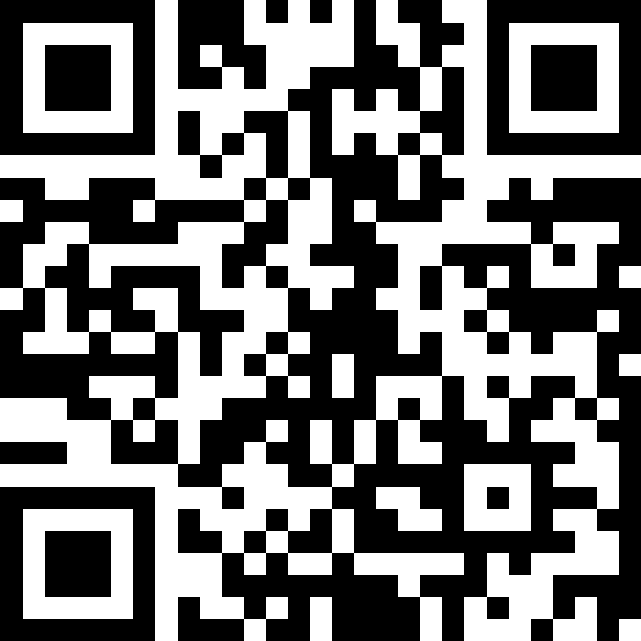
Share your experience!
Scan the QR code for the post-session survey

